Slide 1
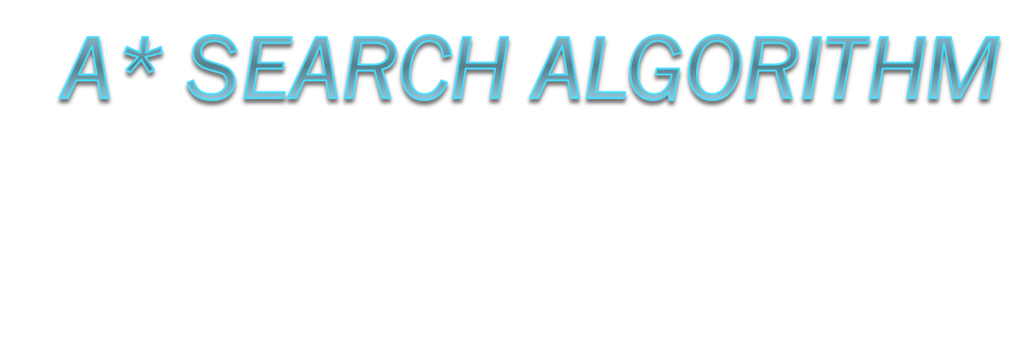
By Sam Shahabi

Slide 2
A* Search Algorithm
What is A*?
  A* is one of the many search algorithms that takes an input, evaluates a number of possible paths and returns a solution
  The goal of this tutorial is to provide background information, details and an example to demonstrate A* search

Slide 3
What is A* Search Good For?
  If there is solution A* will find it, which makes this search algorithm complete
  Similar to greedy best-first search but is more accurate because A* takes into account the nodes that have already been traversed

Slide 4
Path Scoring: How to Calculate the Path Cost
  A* figures the least-cost path to the node which makes it a best first search algorithm.
  Uses the formula F(x)=g(x)+h(x)
    G(x) is the total distance from the initial position to the current position.
    H(x) is the heuristic function that is used to approximate distance from the current location to the goal state.
      This function is distinct because it is a mere estimation rather than an exact value.
      The more accurate the heuristic the better the faster the goal state is reach and with much more accuracy.
    F(x) = g(x)+h(x) this is the current approximation of the shortest path to the goal.

Slide 5
The Open List (Priority Queue) and the Closed List
  When starting at the initial node this search keeps track of the nodes to be traversed.
    This is known as the open set and it keeps track of nodes in order of the lowest f(x) to the highest f(x).
    In order of priority each node is removed from the queue and then the values for f(x) and h(x) neighboring nodes around the removed node are updated.
    This search continues until it reaches the node with the lowest f(x) value, which is called the goal node.
    H(x) at the goal is zero which is an admissible heuristic because the path to the goal is clearly not an overestimate.

Slide 6
The Open and Closed List (cont’d)
If the heuristic function h never overestimates the minimum cost of reaching the goal, also known as being admissible, then A* is also known to be admissible.

Slide 7
Example Using A* Search
  Here we are using Disneyland Paris to provide an example to traverse nodes from an initial state to a goal state.
    The main entrance is the initial node
    The Magic Kingdom is the goal state
    There are two paths that can be taken and are marked by nodes
    Each node will have the f(x), g(x), and h(x).
    Then it will show at each node and indicate which is the next node that it will traverse based on least path cost.

Slide 8
Disneyland Paris
Say you are at the entrance of Disneyland Paris and you are trying to get to the Magic Kingdom.
There are two distinct paths that overlap in the center.
Using A* I will demonstrate how the algorithm traverses nodes and reaches the final destination.

Slide 9
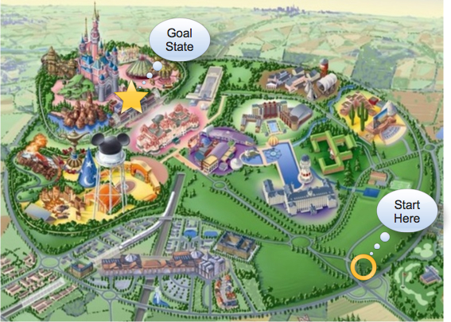
As you can see the initial node and the goal state are labeled accordingly.

Slide 10
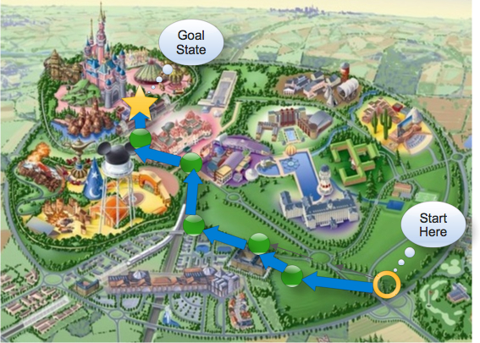
The first path is highlighted in with green nodes.

Slide 11
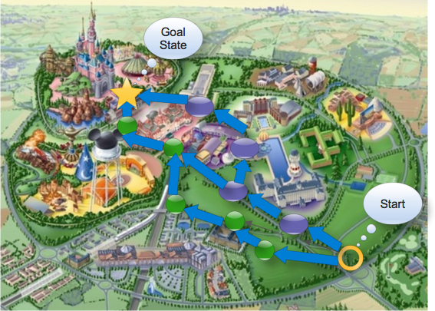
The second path is illustrated with purple nodes and overlaps with the first path

Slide 12
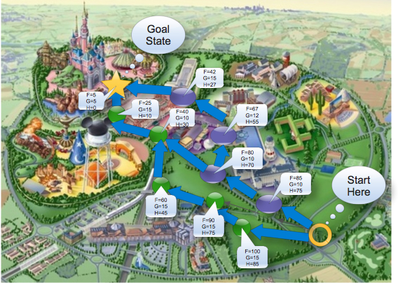
In this stage all of the values are shown for f(x), g(x), & h(x).
Note that in this example the heuristic is not monotonic and therefore we are not using a closed set to keep track of the nodes traversed. Since the closed set is not keeping track of the visited nodes the values of the neighboring nodes of the current node remain the same.

Slide 13
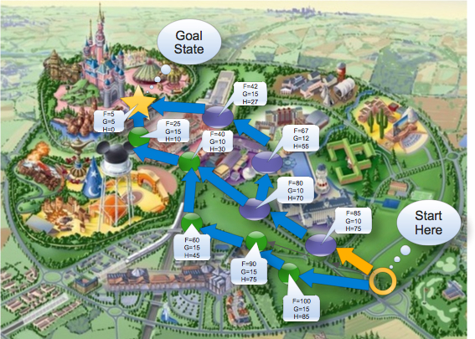
The first node traversed is the one with the lowest f(x) value

Slide 14

The only option is the purple node where F(x)=80

Slide 15
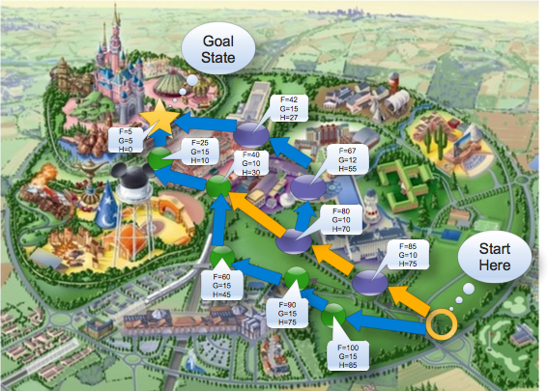
There are two options in this case:
The purple one with the higher F(x)
The green one with the lower F(x)
As mentioned before A* will choose the one with the lowest F(x)

Slide 16
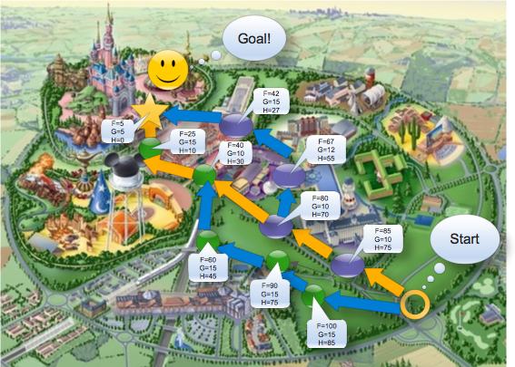
Finally we see that A* found the node with the smallest f(x) value. When the goal node is popped off the priority queue then the search stops.

Slide 17
Conclusion
Recap on A*:
  Uses the formula f(x)=h(x)+g(x)
  Traverses the node with the lowest f(x) value
  Very useful in searching for a goal state
References:
  Slides: cs5300-day03-astar-search.pdf
  Book: Artificial Intelligence: A Modern Approach (Second Edition) pp 97-101

